Slide 1


SOFTWARE ENGINEERING (Week-7)
USAMA MUSHARAF
MS-CS (Software Engineering)
LECTURER (Department of Computer Science)
FAST-NUCES PESHAWAR

Slide 2
AGENDA OF WEEK # 7
4+1 View Model
Discussion on Uber Case Study (System Design)
Towards Object Oriented Design

Slide 3
4+1 VIEW MODEL
The 4+1 view is an architecture verification technique for studying and documenting software architecture design.

Slide 4
THE 4 +1 VIEW MODEL
The 4+1 view model was originally introduced by Philippe Kruchten (Kruchten, 1995).
The model provides four essential views:
the logical view,
the process view,
the physical view,
the development view
and fifth is the scenario view

Slide 5
4+1 VIEW MODEL OF ARCHITECTURE
Logical view
Development view
Scenarios
Process View
Physical View

Slide 6
THE 4+1 VIEW MODEL
Multiple-view model that addresses different aspects and concerns of the system.
Standardizes the software design documents and makes the design easy to understand by all stakeholders.

Slide 7
THE SCENARIO VIEW- USE CASE VIEW
The scenario view describes the functionality of the system, i.e., how the user employs the system and how the system provides services to the users.
It helps designers to discover architecture elements during the design process and to validate the architecture design afterward.

Slide 8
THE LOGICAL OR CONCEPTUAL VIEW
The logical view is based on application domain entities necessary to implement the functional requirements.
The logical view specifies system decomposition into conceptual entities (such as objects) and connections between them (such as associations).

Slide 9
THE LOGICAL VIEW
The logical view is typically supported by
UML static diagrams including class/object diagrams and
UML dynamic diagrams, sequence diagram, state diagram.

Slide 10
THE DEVELOPMENT OR MODULE VIEW
The development view derives from the logical view and describes the static organization of the system modules.
UML diagrams such as package diagrams and component diagrams are often used to support this view.

Slide 11
THE PROCESS VIEW
The process view focuses on the dynamic aspects of the system, i.e., its execution time behavior.
This view maps functions, activities, and interactions onto runtime implementation.
The UML activity diagram support this view.

Slide 12
THE PHYSICAL VIEW
The physical view describes installation, configuration, and deployment of the software application.
It concerns itself with how to deliver the deploy-able system.
The physical view shows the mapping of software onto hardware.
The UML deployment diagrams are often used to support this view.

Slide 13
UBER CASE STUDY

Slide 14
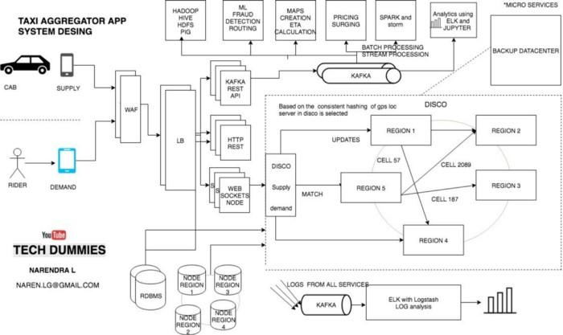

Slide 15
UBERS CASE STUDY
Uber’s technology may look simple but when A user requests a ride from the app, and a driver arrives to take them to their destination.
But Behind the scenes, however, a giant infrastructure consisting of thousands of services and terabytes of data supports each and every trip on the platform.
Like most web-based services, the Uber backend system started out as a “monolithic” software architecture with a bunch of app servers and a single database.

Slide 16
UBERS SERVICES
The challenging thing is to supply demand.
So we need two services
Supply service
Demand service

Slide 17
UBERS SERVICES
Supply service
The Supply Service tracks cars using geolocation (lat and lang).
Every cab which is active keep on sending lat-long to the server every 5 sec once.
Demand service
The Demand Service tracks the GPS location of the user when requested.
Now we have supply and demand. all we need a service which matches they demand to a supply and that service in UBER is called as Dispatch Optimization.

Slide 18
HOW DISPATCH SYSTEM WORKS? HOW RIDERS MATCH TO DRIVERS?
GPS/ location data is what drive dispatch system, that means we have to model our maps and location data.
The earth is a sphere. It’s hard to do summarization and approximation based purely on longitude and latitude.

Slide 19
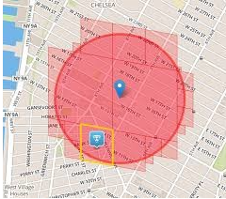
HOW DISPATCH SYSTEM WORKS? HOW RIDERS MATCH TO DRIVERS?
So Uber divides the earth into tiny cells using the Google S2 library. Each cell has a unique cell ID.
S2 can give the coverage for a shape. If you want to draw a circle with a 1km radius centered on London, S2 can tell what cells are needed to completely cover the shape.

Slide 20
HOW DISPATCH SYSTEM WORKS? HOW RIDERS MATCH TO DRIVERS?
ETA (Estimated Time to Arrival)
To compute the ETA of how nearby they are not geographically, but by the road system.

Slide 21
WEB APPLICATION FIREWALL
A web application firewall (WAF) is a firewall that monitors, filters and blocks requests from
block IPs
Bots
Or where UBER service is not launched yet

Slide 22
LOAD BALANCING
Load balancing refers to efficiently distributing incoming network traffic across a group of backend servers, also known as a server farm or server pool.

Slide 23
SUPPLY/ DEMAND

Slide 24
TOWARDS OBJECT ORIENTED DESIGN

Slide 25
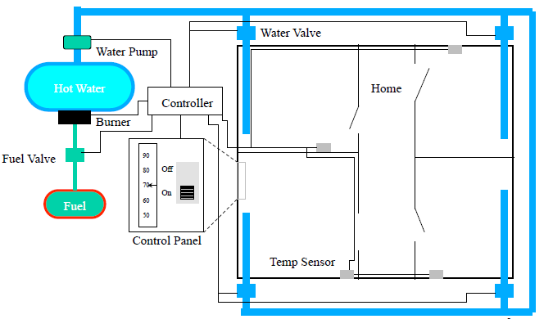
THE HOME HEATING SYSTEM

Slide 26
HOME HEATING REQUIREMENTS
The purpose of the software for the Home Heating System is to control the heating system that heats the rooms of a house. The software shall maintain the temperature of each room within a specified range by controlling the heat flow to individual rooms.

Slide 27
HOME HEATING REQUIREMENTS
The software shall control the heat in each room
The room shall be heated when the temperature is 2F below desired temp
The room shall no longer be heated when the temperature is 2F above desired temp
The flow of heat to each room shall be individually controlled by opening and closing its water valve
The valve shall be open when the room needs heat and closed otherwise
The user shall set the desired temperature on the thermostat
The operator shall be able to turn the heating system on and off

Slide 28
HOME HEATING REQUIREMENTS
The furnace must not run when the system is off
When the furnace is not running and a room needs heat, the software shall turn the furnace on
To turn the furnace on the software shall follow these steps
– open the fuel valve
– turn the burner on
The software shall turn the furnace off when heat is no longer needed in any room
To turn the furnace off the software shall follow these steps
– close fuel valve

Slide 29
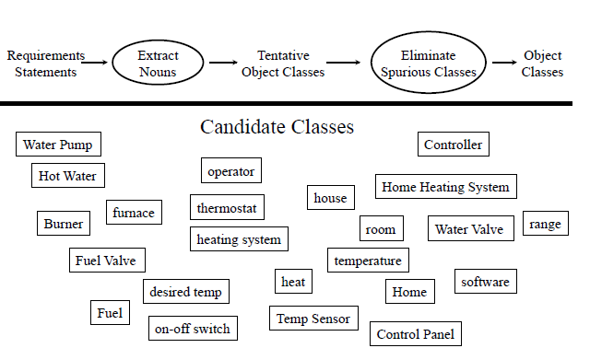
IDENTIFY OBJECT CLASSES

Slide 30
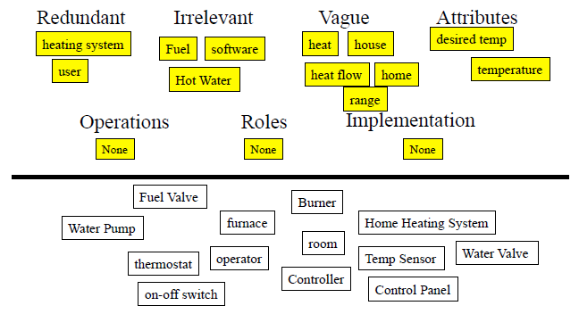
ELIMINATION

Slide 31
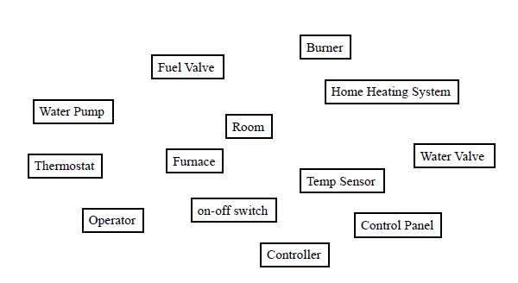
AFTER ELIMINATION

Slide 32
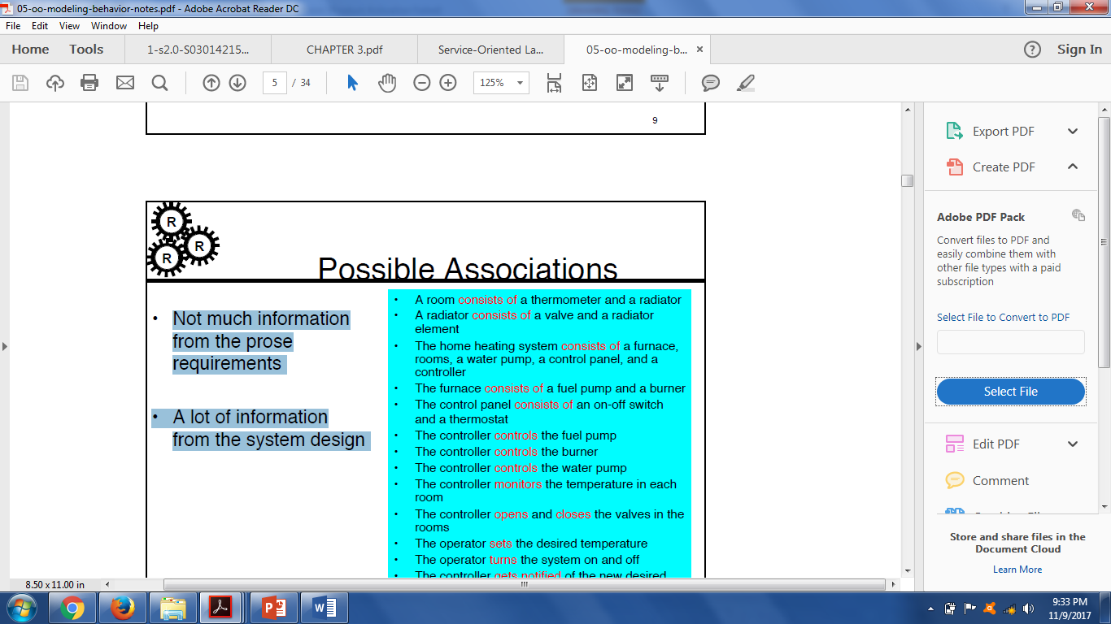
POSSIBLE ASSOCIATIONS

Slide 33
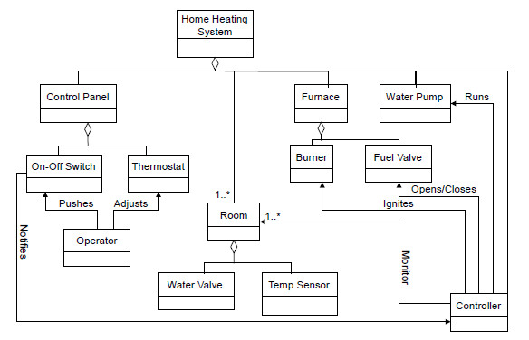
OBJECT MODEL

Slide 34
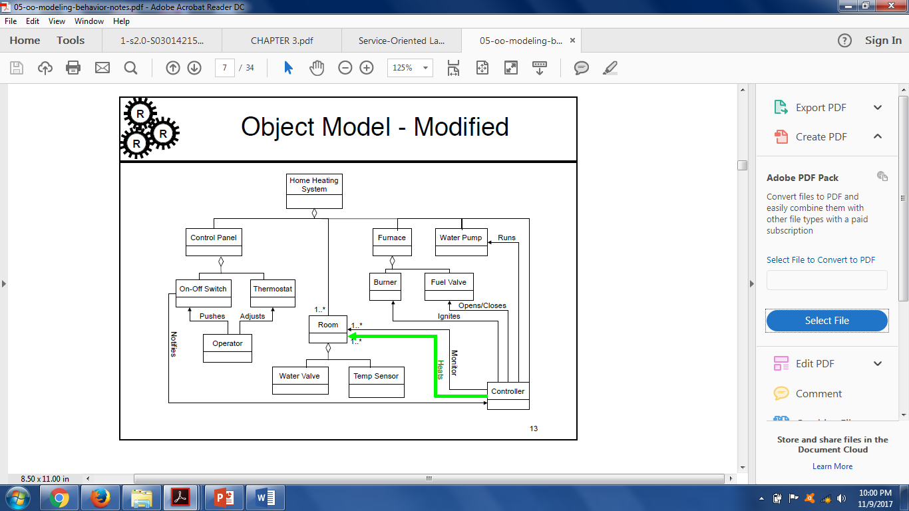
OBJECT MODEL - MODIFIED

Slide 35
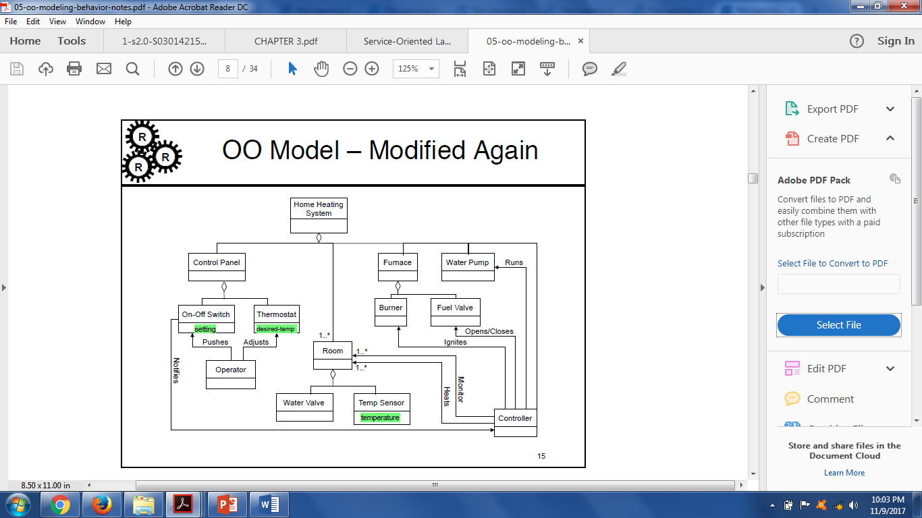
OBJECT MODEL: ATTRIBUTES

Slide 36
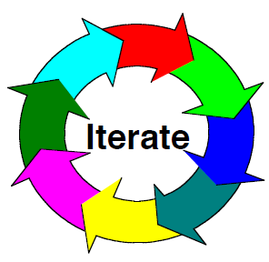
ITERATE THE MODEL
Keep on doing this until you, your customer, and your engineers are happy with the model

Slide 37
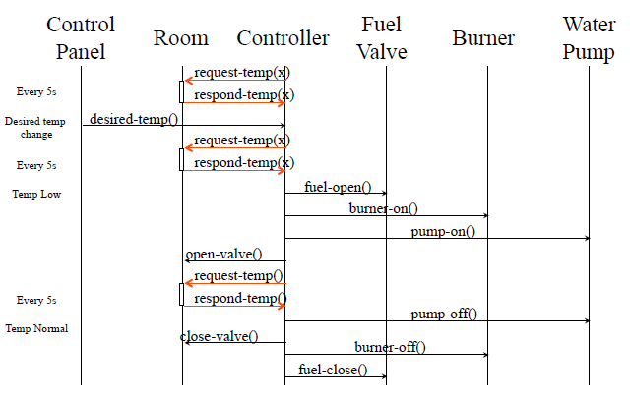
SEQUENCE DIAGRAM

Slide 38
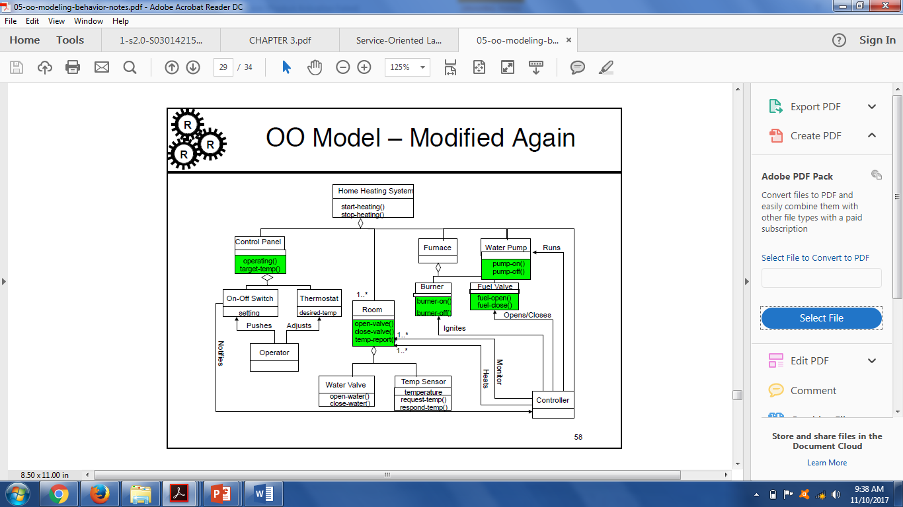
OO MODEL – MODIFIED AGAIN!

Slide 39
ITERATE THE MODEL
Keep on doing this until you, your customer, and your engineers are happy with the model

Slide 40
HAVE A GOO DAY!

